Slide 1
Essay AutoGrader
Final Capstone Project
By Michelle Thorne

Slide 2
Overview
Introduction
Research Question
Data
Collection
Cleaning
Data Exploration and Feature Engineering
The Models
Results and Recommendations

Slide 3
Introduction
Teaching is both a rewarding and exhausting profession
Over 50% of new teachers leave the profession within the first 5 years.
Reasons for teacher burnout include:
Lack of Administrative support
Over-emphasis on standardized testing
Paperwork overload
Increasing difficult student behavior
Challenging interaction with parents
Lack of respect for the profession
Lack of resources

Slide 4

An average full time employee works 2,080 hours per year
Information from https://www.weareteachers.com/teacher-overtime/

Slide 5
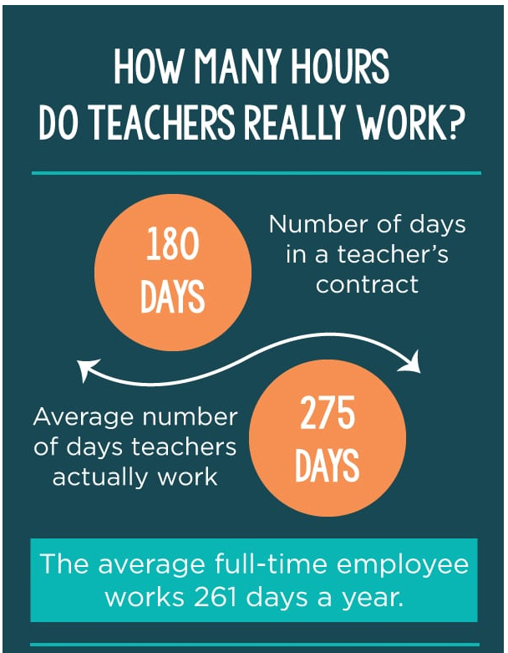

Slide 6


Slide 7


Slide 8
Grading
For a typical teacher load, assignments for a typical day might look like the following:
60 - 10 question quizzes
60 essays
30 class work assignments

Slide 9
Grading
Time needed to grade each assignment:
60 quizzes * 50 sec per quiz = 50 min
60 essays * 12 min per essay = 12 hours
30 class work assignments * 1 min per assignment = 30 min
5 classes of grades to input into electronic gradebook * 1 min per class
This totals to 13 hours and 25 min after a full day of teaching and family responsibilities.

Slide 10
Grading
Essays are the most time consuming assignment to grade.
Class sizes are 25-35
Average student load for core teachers is 150-200+
Total time just for one writing assignment:
30 min * 180 essays = 90 hrs!!

Slide 11
Problem 1:
Teachers spend way too much time grading writing assignments.

Slide 12
Student Writing Skills
Student writing skills have been declining for years.
Reasons include:
Lower standards in earlier grades
Helicopter parents
Technology
Email
Text
Internet

Slide 13
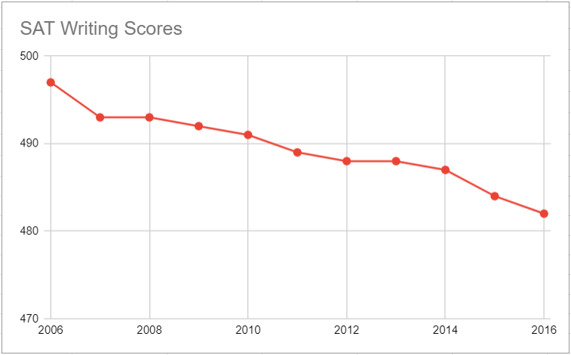

Slide 14
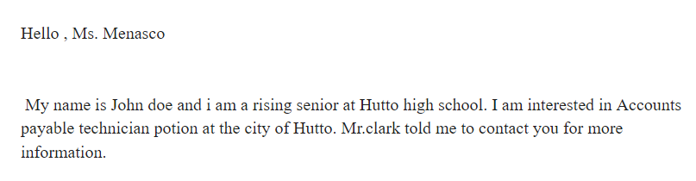

Slide 15
Problem 2:
Students writing skills are declining.

Slide 16
Research Question:
Can we develop an automatic essay grader so students will continue to get writing practice while saving teachers time and avoiding burn out?

Slide 17
The Data
Comes from Kaggle: “The Hewlett Foundation Automated Essay Scoring”
Contains 12,977 essays from students in 7th - 10th grades
Essays are divided up into 8 sets each with a different writing prompt and grading scale.
Each essay:
Was graded by 2 different graders
Had a composite score

Slide 18
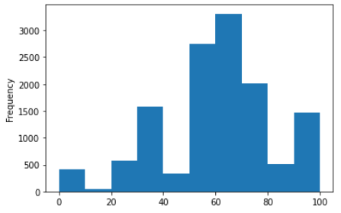
Data Cleaning - Numerical Test Scores
Essay grades needed to be normalized.
Used composite score and divided by max score for each set to achieve a percentage.

Slide 19
Data Cleaning - Numerical Test Scores
Description Stats:
Mean - 60.1
Variance: 527.8
Skewness: -0.332
Kurtosis: 0.087
Tests for Normality:
Shapiro-Wilks:
W - 0.95
p value - 0.0
Jarque-Bera - 228.66
p value - 0.0
Normality - 217.94
p value - < 0.05

Slide 20
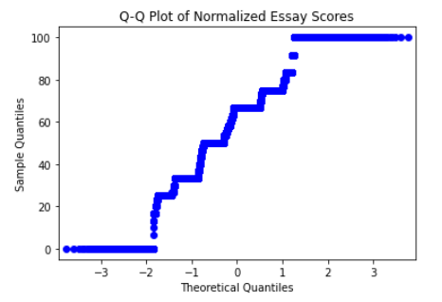
Data Cleaning - Numerical Test Scores

Slide 21
Data Exploration and Feature Engineering
Flesch Reading Ease
Flesch Kincaid Grade
Smog Index
Automated Readability Index
Lexicon Count
Sentence Count
Readability Consensus

Slide 22
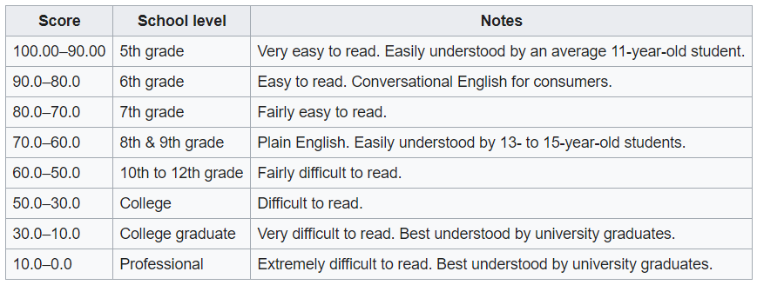

Flesch Reading Ease Score
The score indicates how easy material is to read.

Slide 23
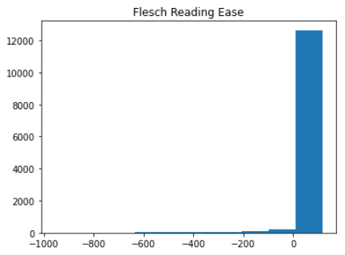
Flesch Reading Ease Score
The score indicates how easy material is to read.
Mean: 63.94

Slide 24
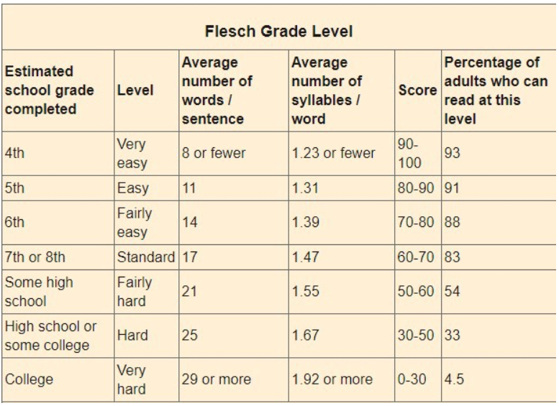
Flesch Kincaid Score
The score is used extensively in education. It gives the US grade level so educators and parents can judge the difficulty of books and texts.

Slide 25
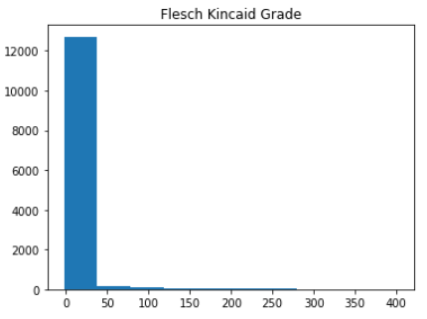
Flesch Kincaid Score
It gives the US grade level that is appropriate for a given text.
Mean: 11.2

Slide 26
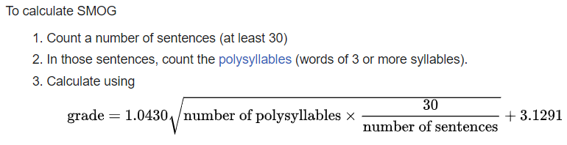
SMOG Index
The score indicates the number of years of education needed to understand a piece of writing.
SMOG is an acronym for “Simple Measure of Gobbledygook”

Slide 27
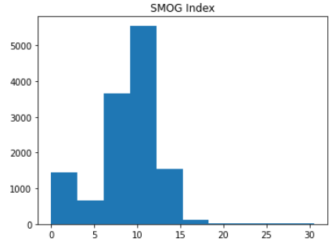
SMOG Index
The score indicates the number of years of education needed to understand a piece of writing.
Mean: 8.7

Slide 28
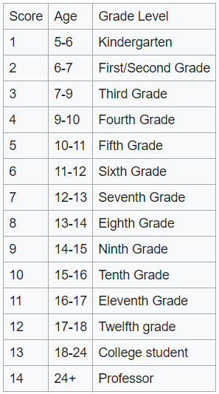
Automated Readability Index
The score represents the understandability of a text.
The score indicates the grade level needed to comprehend the text.

Slide 29
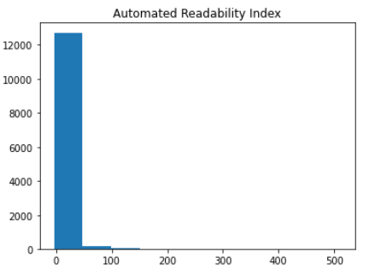
Automated Readability Index
The score represents the understandability of a text.
The score indicates the grade level needed to comprehend the text.
Mean: 13.3

Slide 30
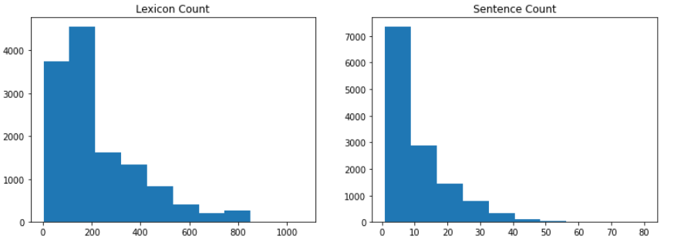
Lexicon Count
Sentence Count
Lexicon count indicates the number of words in a text.
Mean: 222.4
Sentence Count indicates the number of sentences in a text.
Mean: 10.7

Slide 31
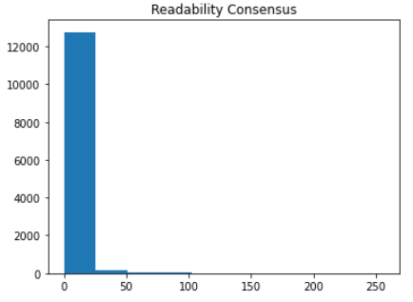
Readability Consensus
This function returns the estimated school grade level based on all the tests available in the textstat python package.
Mean: 10.2

Slide 32
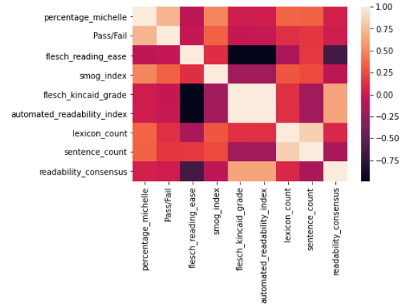
Data Exploration - Correlation
Flesch Kincaid & Automated Readability (0.997)
Lexicon Count & Sentence Count (0.85)
Flesch Reading Ease & Flesch Kincaid(-0.987)
Flesch Reading Ease & Automated Readability ( -0.978)

Slide 33
Data Cleaning and Processing - Text based
Essays were parsed using en_core_web_lg
Stop words were removed and lemmas were extracted
Text to number conversion methods
Tf_idf with n_grams
Spacy vectors
Universal Sentence Encoder from TensorFlow

Slide 34
The Models
Final datasets included:
Tf_idf vectorizer with n_grams was limited to 2000 features and was joined with the text stats for each essay
Spacy vectors had 300 features and was joined with the text stats
Universal Sentence Encoder from TensorFlow also had 300 features and was joined with text stats

Slide 35
The Models
Three Models were used and Grid Search was used for hyper parameter tuning.
Random Forest Classifier
Random Forest Regressor
Parameters were:
N_estimators = [300, 500, 1000]
Max_depth = [20, 50, None]
Train_test_split was 25%
Random_state was used to ensure the same split
Target variable was the essay score

Slide 36
TF-IDF
Random Forest Classifier
Training Score - 0.999
Test Score - 0.496
Most Important Features: Lexicon Count
CV (5 folds) average: 45%
Random Forest Regressor
Training Score - 0.946
Test Score - 0.607
Most Important Features: Lexicon Count (40%)
CV (5 folds) average: 45%

Slide 37
SpaCy Vectors
Random Forest Classifier
Training Score - 0.999
Test Score - 0.515
Most Important Features: Lexicon Count
CV (5 folds) average: 47%
Random Forest Regressor
Training Score - 0.95
Test Score - 0.645
Most Important Features: Lexicon Count (40%)
CV (5 folds) average: 44%

Slide 38
Universal Sentence Encoder
Random Forest Classifier
Training Score - 0.999
Test Score - 0.527
Most Important Features: Lexicon Count
CV (5 folds) average: 50%
Random Forest Regressor
Training Score - 0.951
Test Score - 0.645
Most Important Features: Lexicon Count (40%)
CV (5 folds) average: 45%

Slide 39
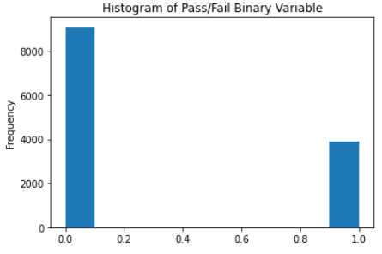
Binary Models
Random Forest Classifier was used for each data representation for comparison.
All parameters remained the same for comparison
New Target Variable:
Pass (1)
Score >70
3890 essays
Fail(0)
Score <= 70
9087 essays

Slide 40
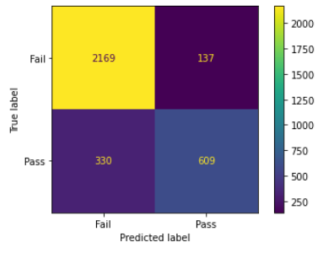
Binary Model - TF-IDF
Training Score: 0.999
Test Score: 0.856
Most Important Feature: Lexicon Count
Accuracy Score: 0.86
Precision Score (accuracy of positive identification): 0.82
Recall Score (accuracy of true positives identified): 0.65

Slide 41
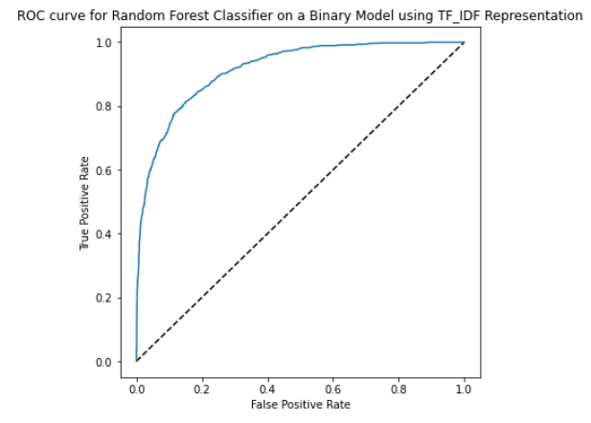
Binary Model - TF-IDF

Slide 42
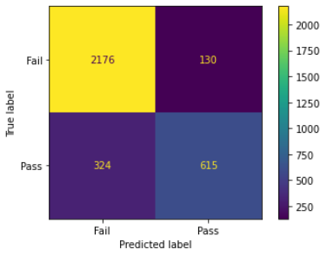
Binary Model -
SpaCy Vectors
Training Score: 0.999
Test Score: 0.86
Most Important Feature: Lexicon Count
Accuracy Score: 0.86
Precision Score (accuracy of positive identification): 0.83
Recall Score (accuracy of true positives identified): 0.68

Slide 43
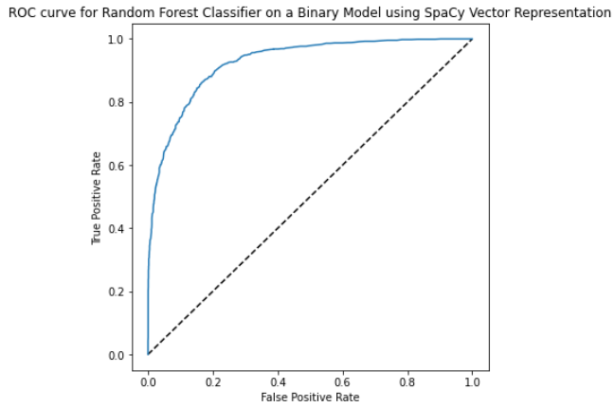
Binary Model -
SpaCy Vectors

Slide 44
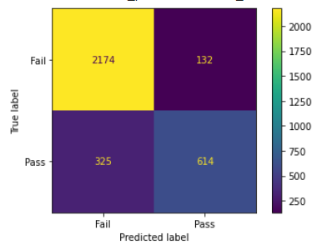
Binary Model -
USE Vectors
Training Score: 0.999
Test Score: 0.859
Most Important Feature: Lexicon Count
Accuracy Score: 0.86
Precision Score (accuracy of positive identification): 0.82
Recall Score (accuracy of true positives identified): 0.65

Slide 45
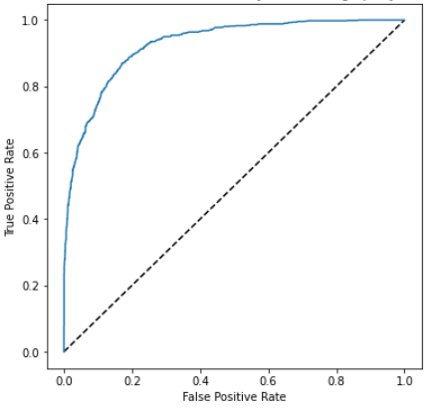
Binary Model -
USE Vectors

Slide 46
Results
No significant difference between the different vector representations of the student essays
No significant difference between Random Forest Classifier and Random Forest Regressor
Results were poor, even though binary model showed mild improvement
Possible causes might be:
Data not normally distributed
Low correlation between many of the features

Slide 47
Recommendations
Collect wider range of essays from elementary grades through college.
Wider range of writing skill representation
Allow user to optimize attributes and parameters for grading specific writing level.
Model Suggestions:
Random Forest Classifier (Speed)
SpaCy or USE vector representation (Memory conservation)

Slide 48
Thanks!
Any questions?

